Slide 1
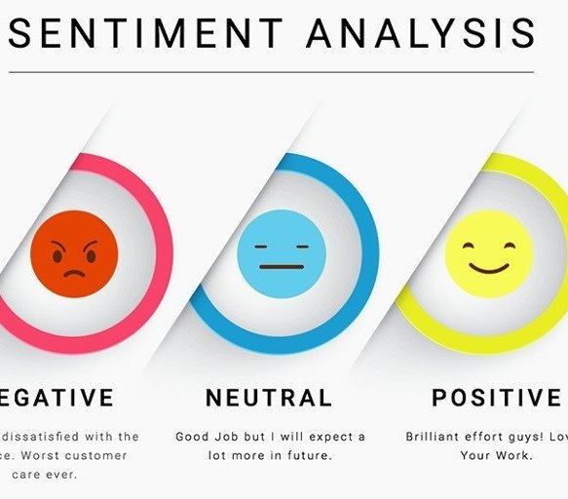
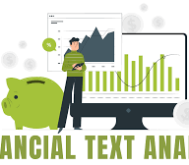
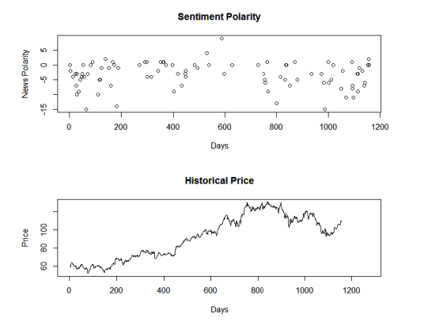

The project done by Group 4
Group 4 consist of following members:
Madan K
Kuldeep Mishra
Vansh Shyam Shrivastava
Mr. Karthikeyan Ravindran Pillai
FINANCIAL SENTIMENTAL ANALYSIS (P – 203)

Slide 2

Business Problem:
Need to Perform Sentimental Analysis of Financial Statements and Guage it's impact i.e Positive , Negative or Neutral on the Business and Government.

Slide 3
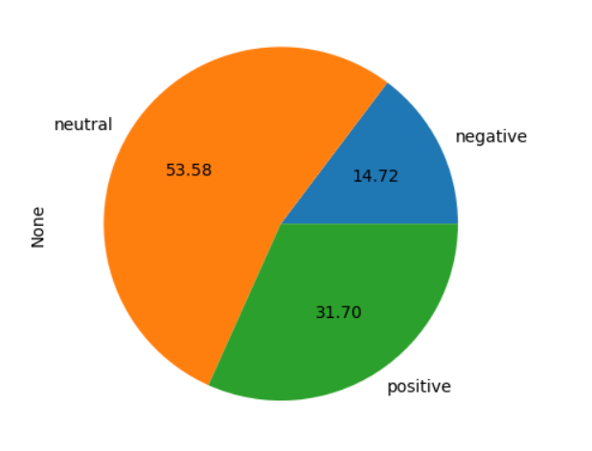
Project Architecture / Project Flow
Loading Dataset
Descriptive Pre – Analysis of Reviews
Dealing With Duplicate Values
How?
Imputation
By Lemmatize or stem words , Combine duplicate values
Deletion
If the duplicate values are exact duplicates

Slide 4
Project Architecture / Project Flow
Text Preprocessing
Model Building
Model Evaluation
Deployment
Remove both the leading and the trailing
characters removes empty strings, because
they are considered in python as false joining
the list into one string/text
Remove twitter username handles from a given
twitter text. (Removes @usernames)
Again joining the list into one string/text
Remove punctuations
Remove https or url within text
Converting into text tokens
Tokenization
Remove stopwords
Normalize the data
Stemming (optional)
Lemmatization

Slide 5
INTRODUCTION
Financial sentiment analysis is the process of extracting and analyzing the opinions, emotions, and attitudes expressed in financial data such as news articles, social media posts, and company filings.
It is used to gain insights into the market sentiment about a particular company or financial asset, which can be useful in making investment decisions.
Sentiment analysis in finance involves applying natural language processing (NLP) techniques to automatically categorize the sentiment of financial news articles, tweets, and other data sources as either positive, negative, or neutral.
The output of sentiment analysis can be used to determine market sentiment about a particular asset or company, and can be used to predict future price movements

Slide 6
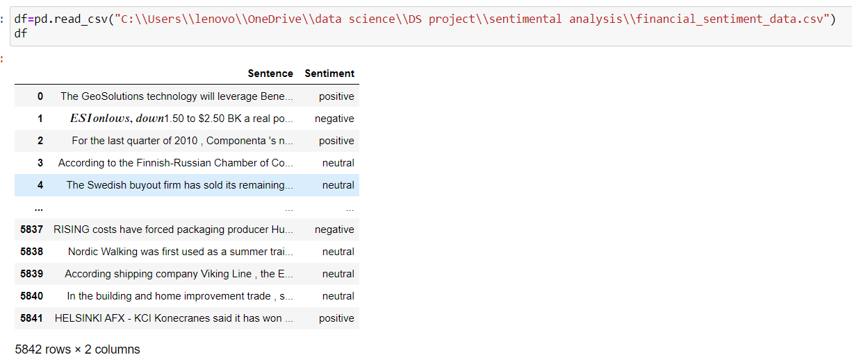
Objective:The objective of financial sentiment analysis is to identify and quantify the sentiment of market participants towards a particular asset, market, or industry. The methodology typically involves collecting data from various sources, such as news articles, social media, and financial reports, and then analyzing this data to extract sentiment signals.
Methodology:Sentiment analysis can be both supervised and unsupervised depending on the approach and data available
Database Summary:
One dataset are being provided:
Dataset consists of two features Sentence and Sentiment

Slide 7
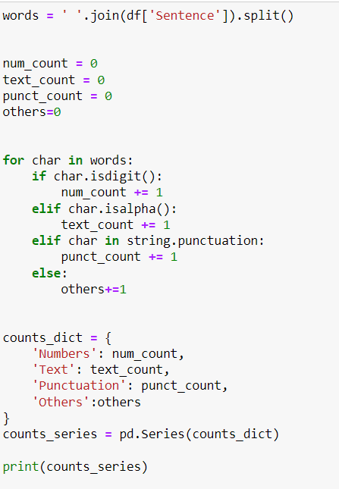
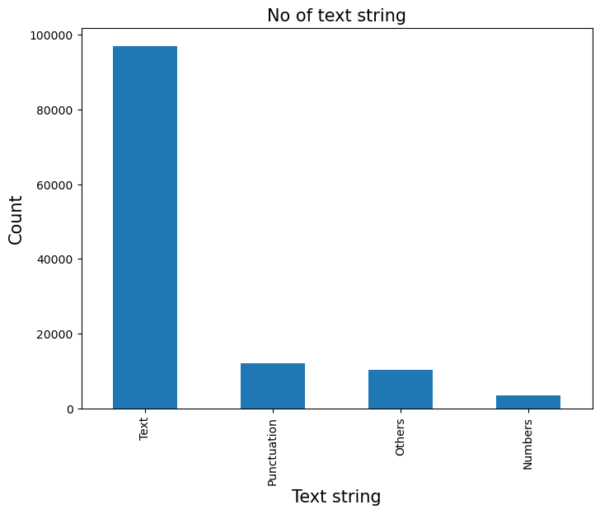
The bar chart data includes a total text count of 96964, indicating the number of words or characters included in the reviews being analyzed.
There were 3463 instances of numbers included in the text data, which may be relevant for further analysis
The text data also included 12030 instances of punctuation, such as periods, commas, and exclamation points.
There were 10253 instances of "other" characters, which may include special characters or symbols that are not typically used in text, or characters from other languages..
Understanding the breakdown of text data by these different categories can provide insights into the characteristics of the reviews being analyzed.

Slide 8
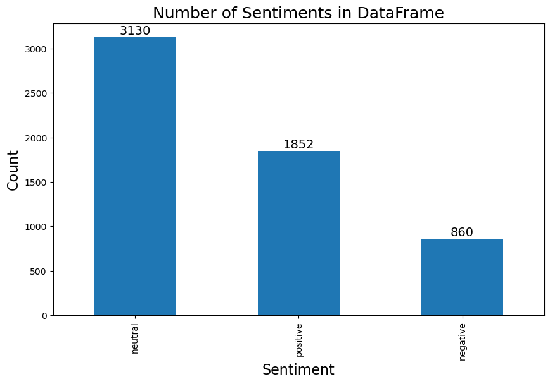
The majority of the reviews were classified as neutral, with a total count of 3130 reviews.
There were 1852 reviews that were classified as positive.
In contrast, there were only 860 reviews that were classified as negative.
The ratio of positive to negative reviews is about 2:1, suggesting that the product or service being reviewed is generally well-received.
Understanding the breakdown of reviews by sentiment is important for further analysis and can help identify areas for improvement, as well as highlight what is already working well

Slide 9
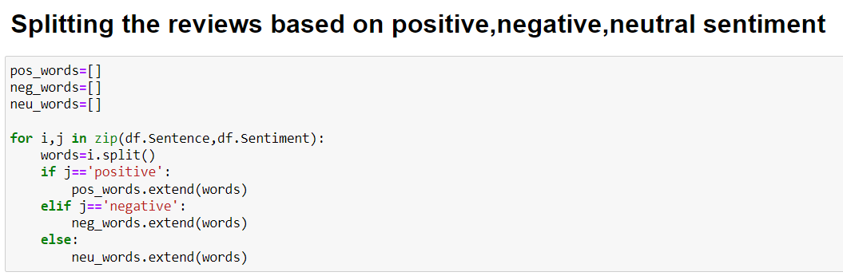
Pre-analysis of given data:
Pre-analysis involves preprocessing the text data to make it ready for sentiment analysis. This may include tasks such as removing stopwords, stemming or lemmatizing words, and converting text to lowercase.
The next step in pre-analysis is to categorize the reviews based on sentiment, which typically involves using a machine learning algorithm or a lexicon-based approach. Once the reviews are categorized, visualizations such as bar charts, word clouds, and histograms are used to analyze the data and gain insights.
Bar charts are used to compare the number of positive, negative, and neutral reviews.
Word clouds can provide a quick snapshot of the most common words used in each sentiment category.
Histograms can help to identify the distribution of review lengths or the frequency of specific words.
Overall, pre-analysis is a crucial step in sentiment analysis because it helps to ensure that the data is accurately categorized and ready for further analysis.

Slide 10
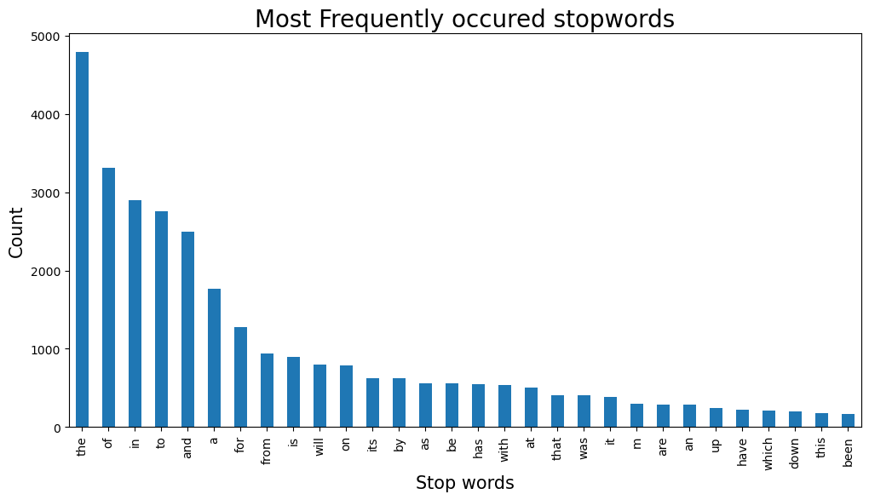
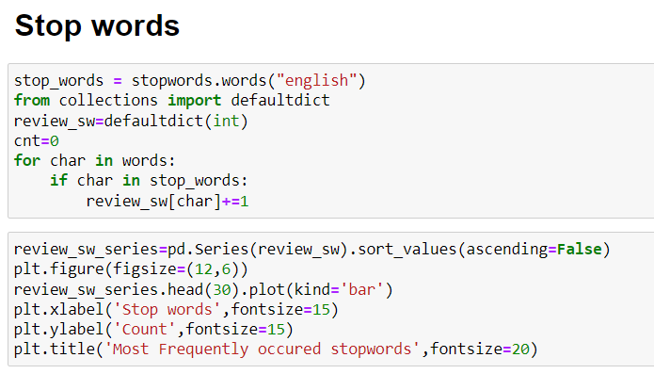
Stop words
After analyzing the text data, it was observed that certain words appeared more commonly than others. These included common stopwords like "the", "of", "an", "to", "and", "a", "for", "from", "is", "will", "on", and "by“ etc….

Slide 11
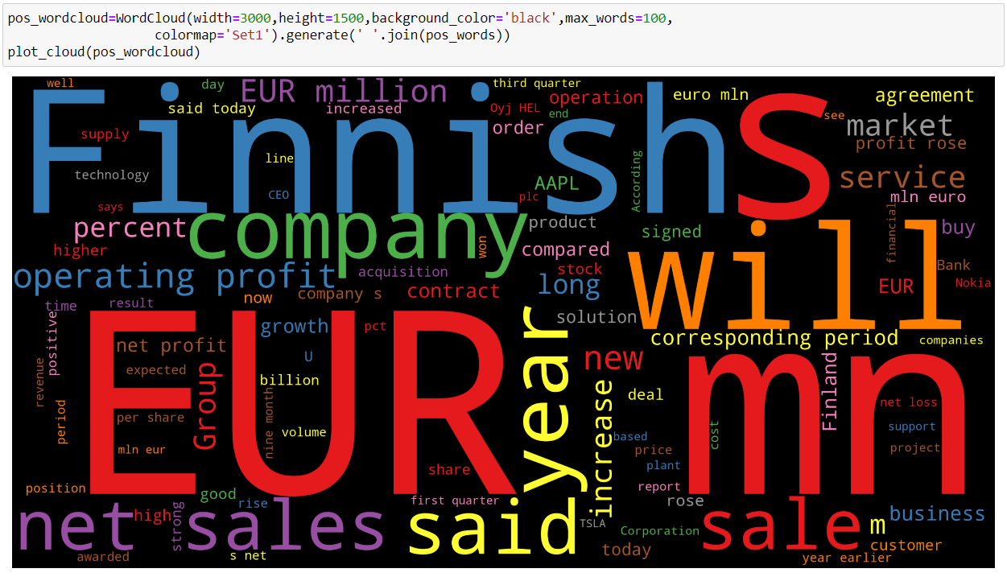
Analyzing on positive words

Slide 12
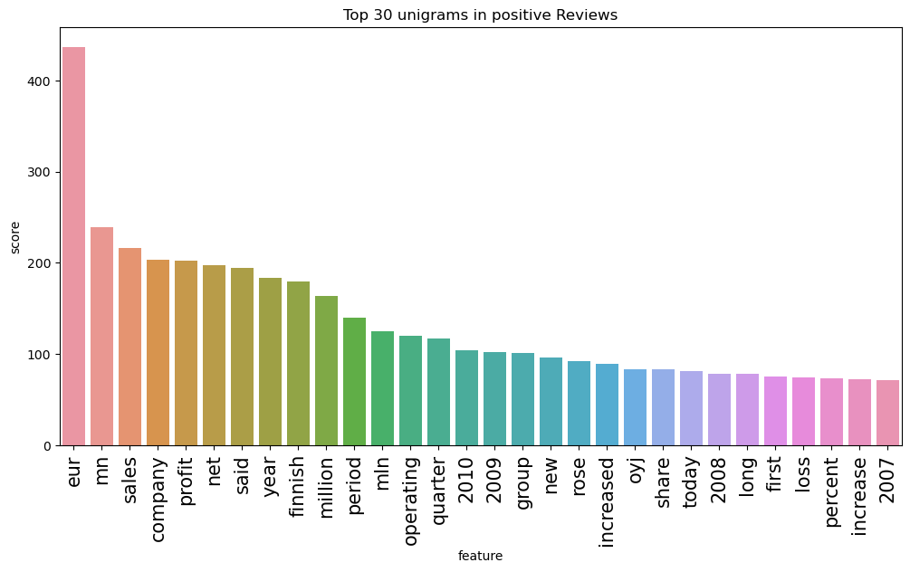
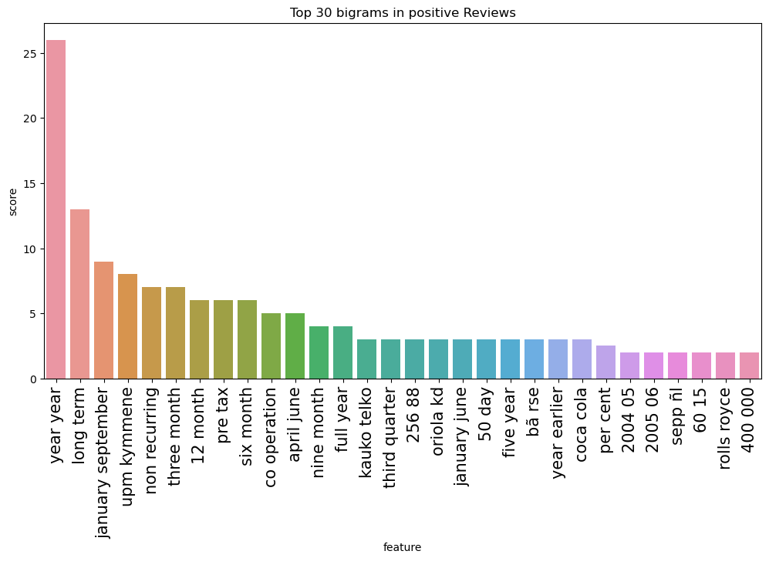
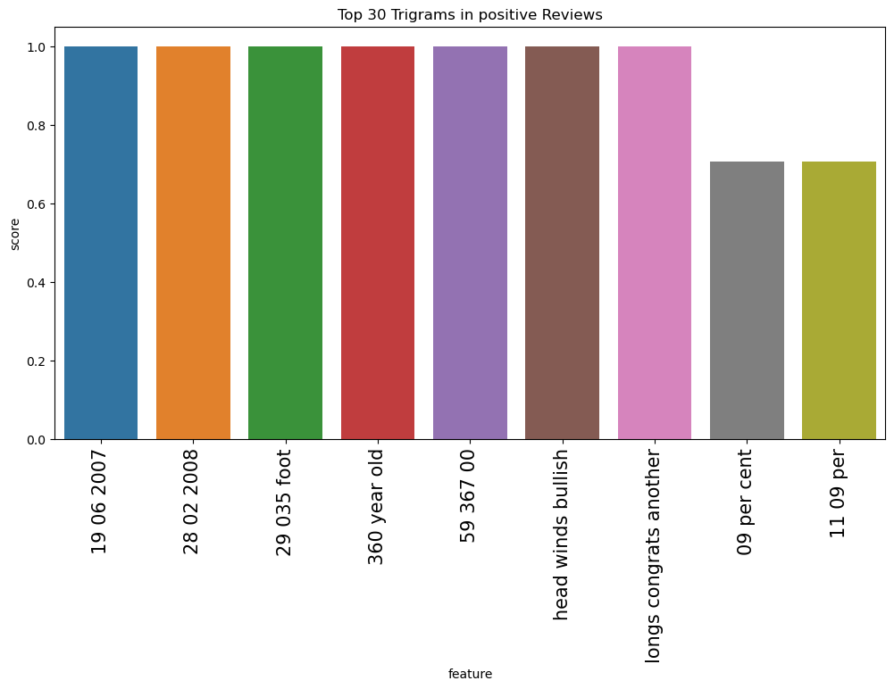
Unigram-positive reviews
The unigrams "Eur", "mn", "sales", "company", "profit", and "net" were found to be the most significant contributors in positive reviews, based on analysis of the text data
Bigram-positive reviews
The most frequent bigrams in positive reviews were found to be "year year", "long term", "non recurring", "three month", "pre tax", and "six month“.
Trigram-positive reviews
The most frequent trigrams in positive reviews were found to be "head wind bullish", "longs congrats another", and "360 year old".

Slide 13
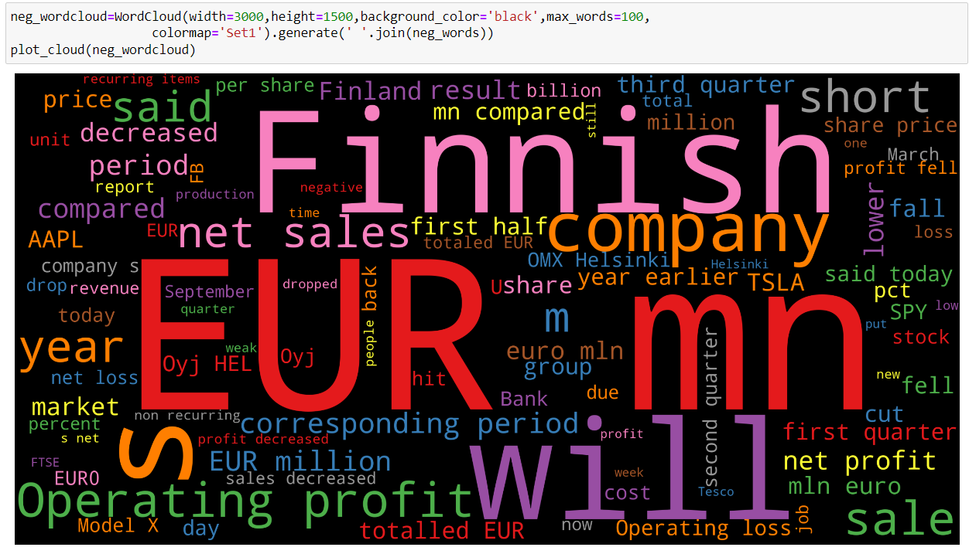
Analysing on Negative Reviews

Slide 14
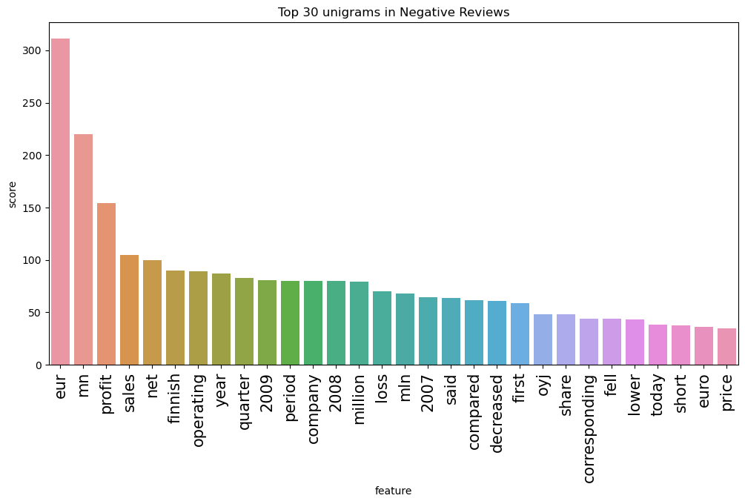
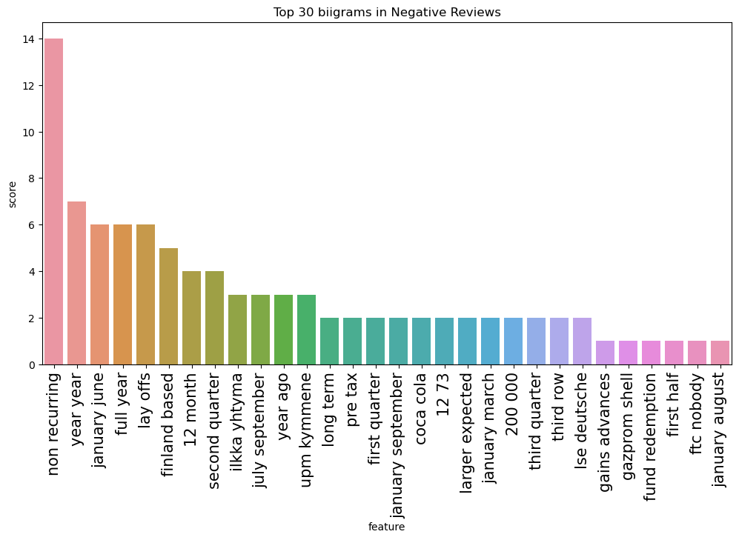
Unigram-Negative reviews
The unigrams "Eur", "mn", "sales", "company", "profit", “operating’,”Finnish” and "net" were found to be the most significant contributors in Negative reviews, based on analysis of the text data
Bigram-Negative reviews
The most frequent bigrams in Negative reviews were found to be "year year", “layoffs”,”Coca cola”, "non recurring", "three month", "pre tax", and "six month“.

Slide 15
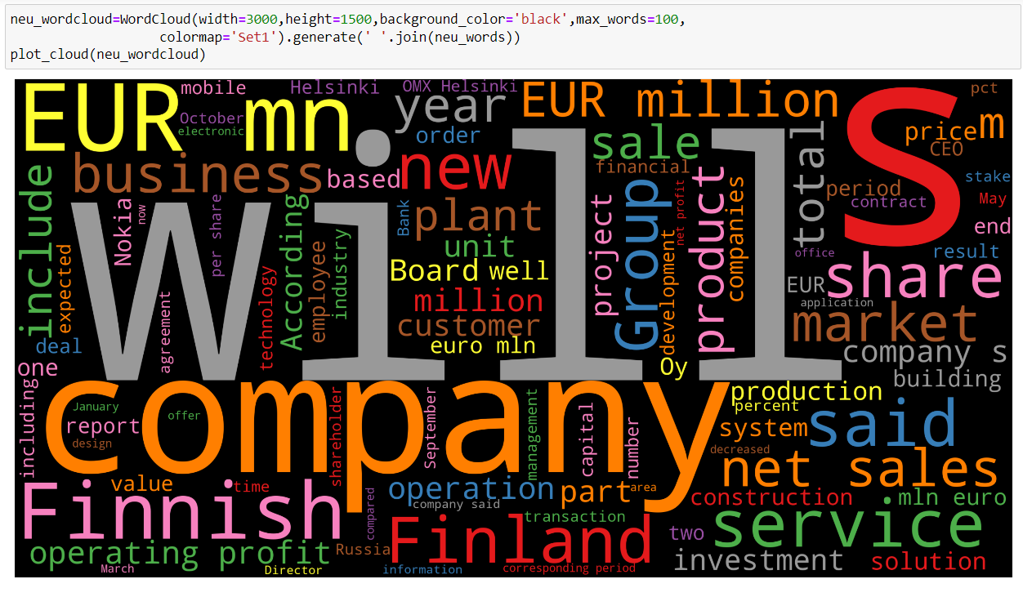
Analysing on Neutral reviews

Slide 16
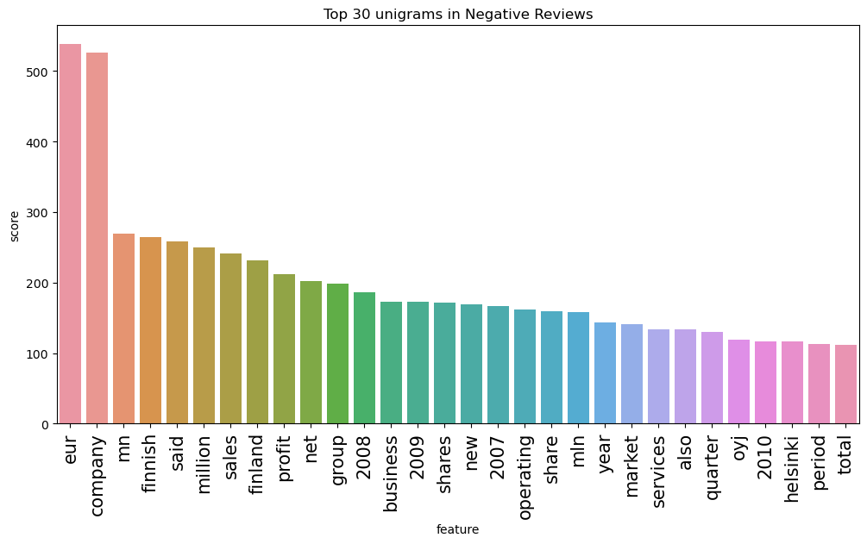
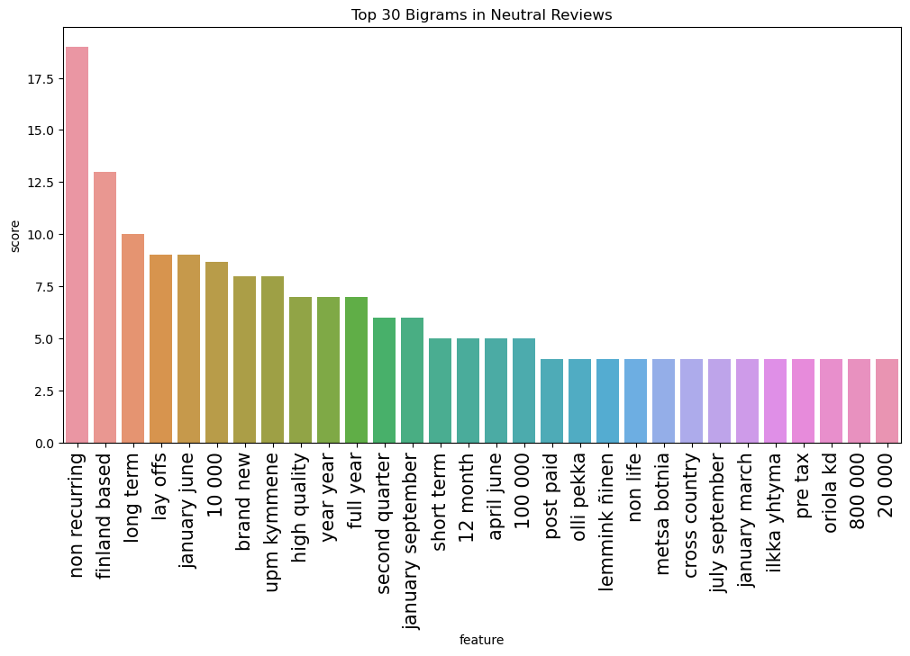
Unigram-Neutral reviews
The unigrams "Eur", "mn", "sales", "company", "profit", “operating’,”Finnish” and "net" were found to be the most significant contributors in Neutral reviews, based on analysis of the text data
Bigram-Neutral reviews
The most frequent bigrams in Negative reviews were found to be "year year",”finland based”,“layoffs”,”Coca cola”, "non recurring", "three month", "pre tax", "six month“,”long term”,”brand new”.

Slide 17
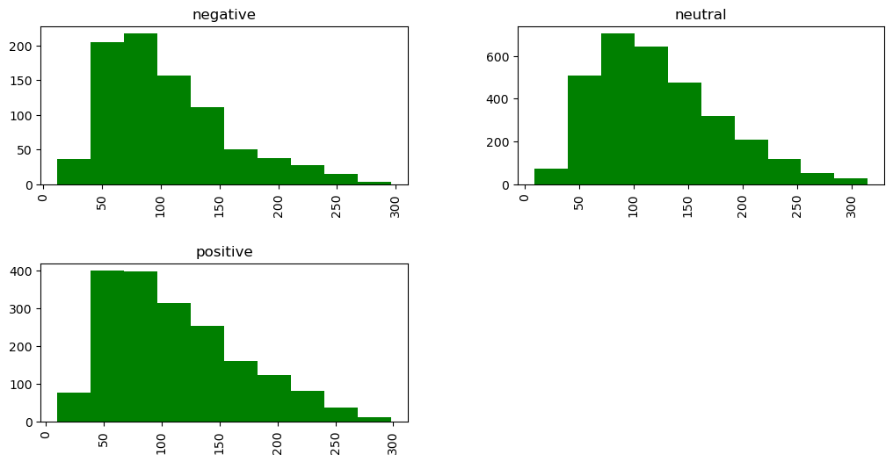
Length of reviews
The average length of positive reviews is slightly higher than the average length of negative reviews (112.16 vs. 105.33), but the difference is relatively small.
The standard deviation for review length is fairly consistent across all three sentiment categories, with values ranging from 51.80 to 56.87.
Neutral reviews have the highest maximum length (315), while positive reviews have the lowest minimum length (10). This suggests that there is more variation in the length of neutral reviews, and that positive reviews tend to be longer on average.

Slide 18
Text Preprocessing
It is estimated that ~80% of all the available data are unstructured data.
Wiki
Blog Posts
News Articles
Various kinds of Business and Administration Documents
Books
Financial and other Business Reports.
Why Text Preprocessing ?
Text preprocessing improves the performance of an NLP system. For tasks such as sentiment analysis, document categorization, document retrieval based upon user queries, and more, adding a text preprocessing layer provides more accuracy.

Slide 19
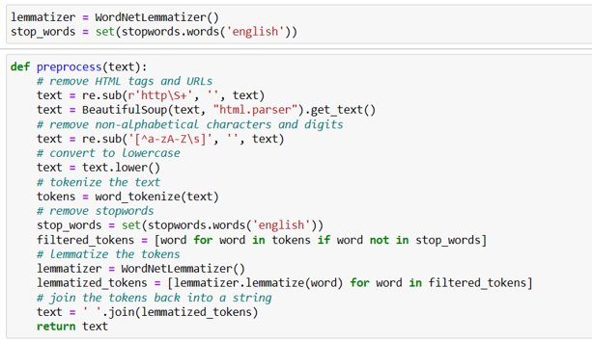
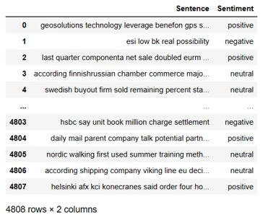
Text Preprocessing
Transforming Text into Data Structures:
Tokenization: It is One of the Fundamental Things to do in Any Text-Preprocessing Activity. It Breaks the Documents or Sentences into Chunks called Tokens. Each Token Carries a semantic meaning Associated with it.
{converting byte to byte}
Example: The capital of China is Beijing
Tokens : capital China Beijing
Grammatical Words : Stops words { The, of , is }

Slide 20
Text Preprocessing
Processing
Normalization
Makes the Data Standardized
Makes Everything in Small [Lower Case]
Remove Punctuation Marks
Removing Low and High Frequency Words
Low Frequency – outliners
High Frequency – Obvious Words
Removing So Called Stop-Words
Grammatical Words
Location stopwords
Time stopwords
Reducing Words to Their Root Form Through Stemming or Lemmatization.
Stemming : Reduces the words to its root form[Removes last 2 – 3 words]
Lemmatization(Real life) : It has a dictionary, it also reduce to its root word [Without Removing Last Letters]

Slide 21

Term Frequency – Inverse Documents Frequency
TF – IDF Approach Follows a weights Scheme Based on the High/Low Frequency of Words for in a Text Corpus.TF-IDF is also an occurrence-based method for vectorizing text and extracting features out of it. It is a composite of two terms, which are described as follows

Slide 22
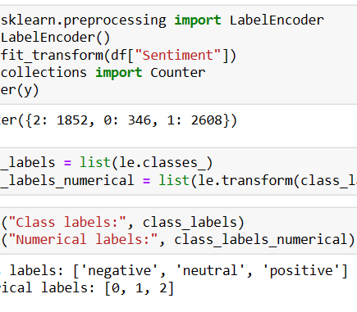
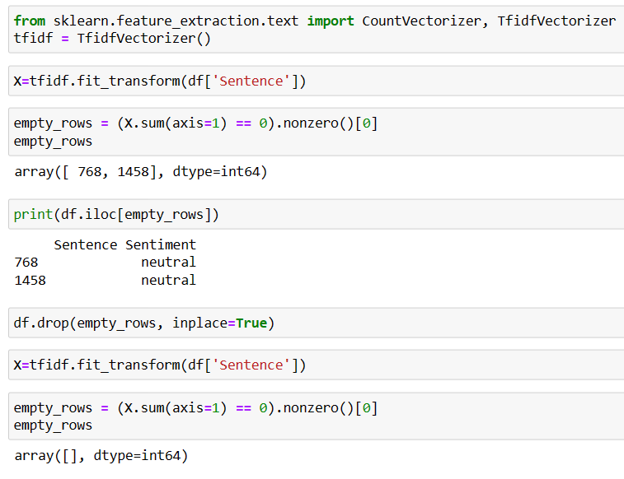
Term Frequency – Inverse Documents Frequency

Slide 23
MODEL BUILDING

Slide 24
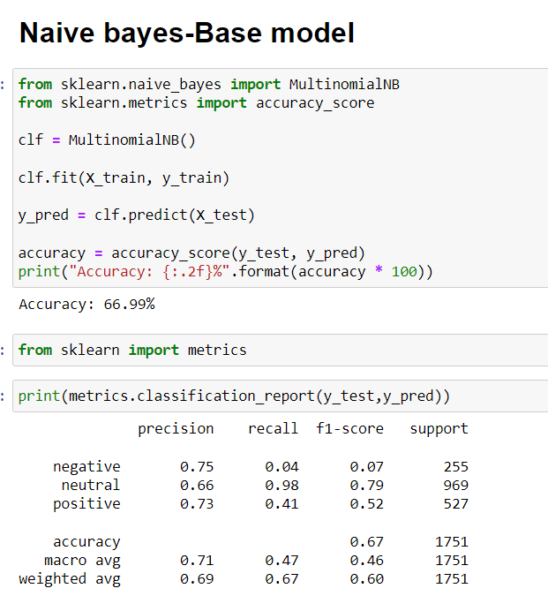
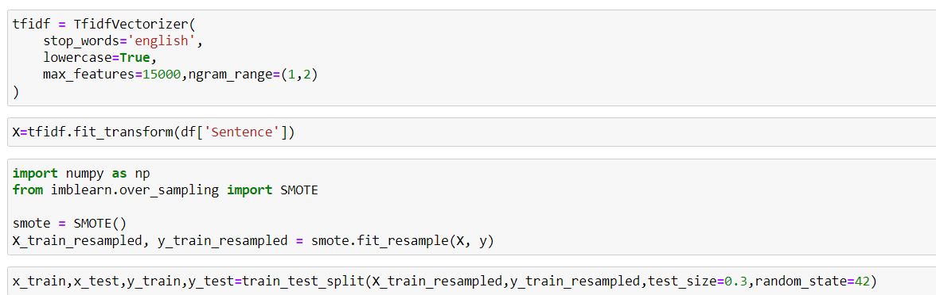
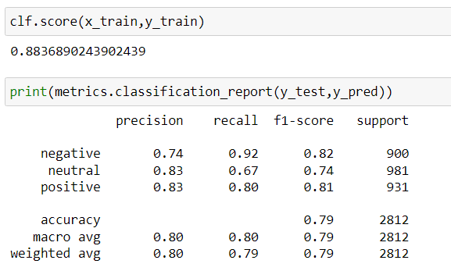
MODEL BUILDING-Smote

Slide 25
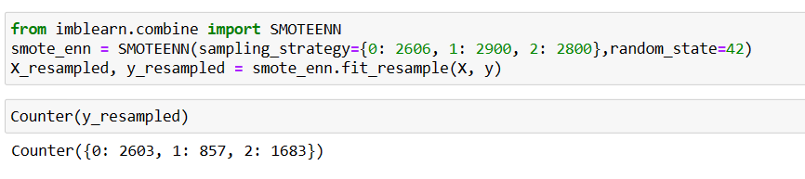
SMOTEENN- combination of up and down sampling
SMOTE-ENN is used for imbalanced classification problems where the number of samples in one class (the minority class) is much smaller than the other (the majority class).
SMOTE-ENN first applies the SMOTE technique to generate synthetic samples of the minority class by interpolating between existing minority class samples.
Next, ENN is used to remove noisy and borderline samples from both the minority and majority classes. ENN removes samples whose class label is different from the majority of their k-nearest neighbors.
SMOTE-ENN can help improve the performance of machine learning models by increasing the number of samples in the minority class and reducing the impact of noisy and borderline samples.

Slide 26
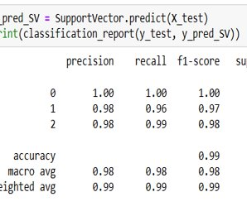
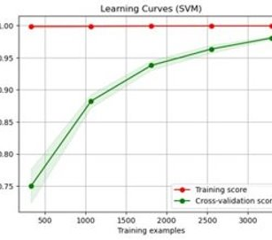
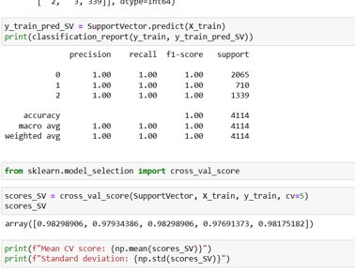
Support Vector Machine

Slide 27
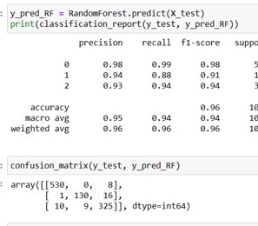
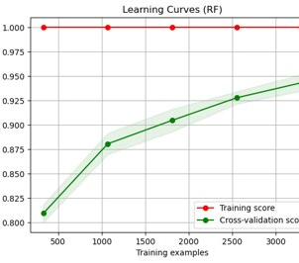
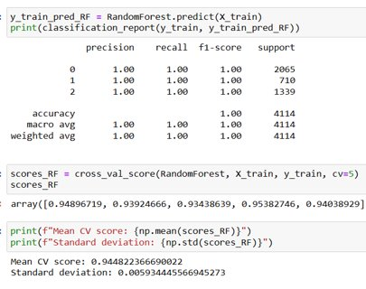
Random Forest

Slide 28
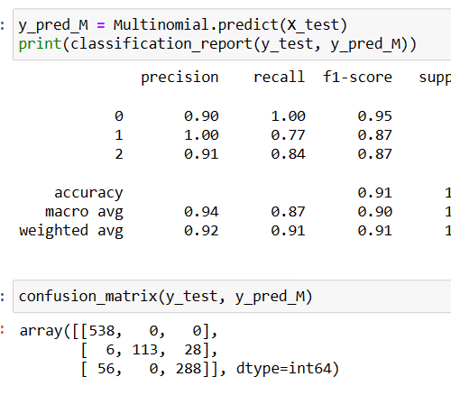
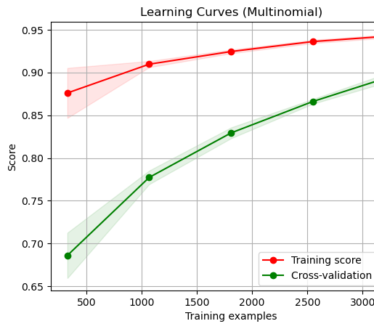
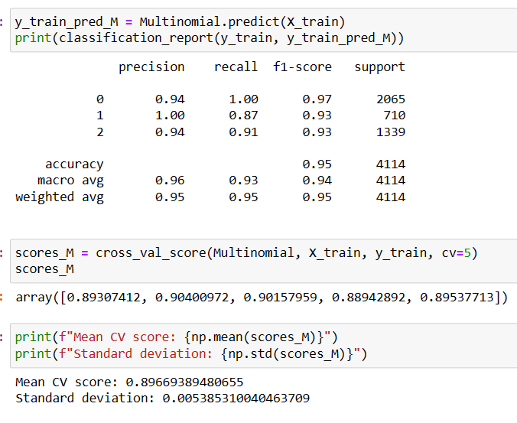
Naive Bayes 'MultinomialNB'

Slide 29
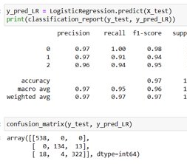
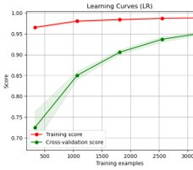
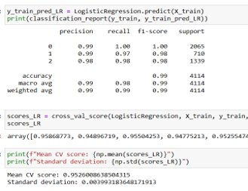
Logistic Regression

Slide 30
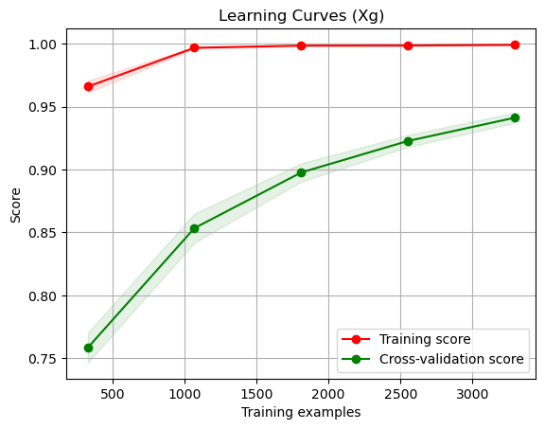
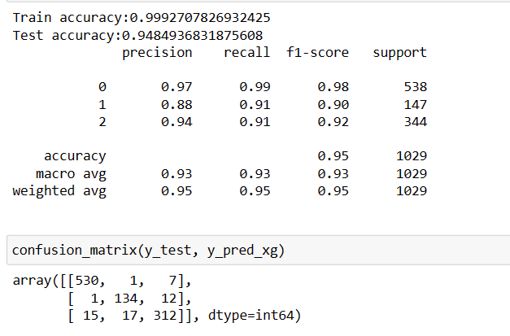
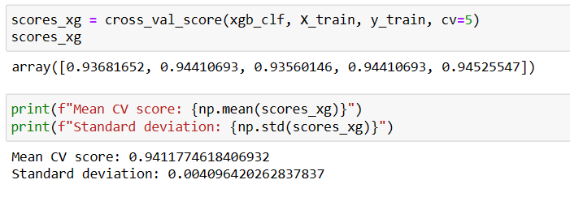
XGBoost

Slide 31
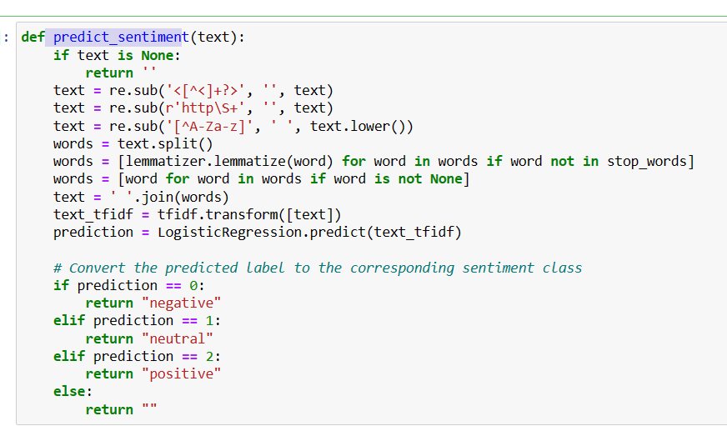
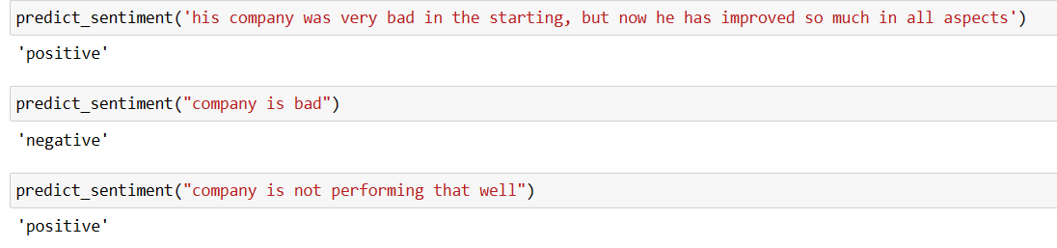
Predicting Sentiments

Slide 32
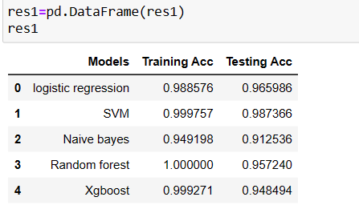
Results of Model using Tf-idf
conclusions:
- SVM outperformed the other models on both the train and test sets, achieving an accuracy of 99.98% on the train set and 98.74% on the test set.
- Logistic regression also performed well, achieving an accuracy of 98.86% on the train set and 96.60% on the test set.
- Naive Bayes had the lowest performance of the models evaluated, achieving an accuracy of 94.92% on the train set and 91.25% on the test set.
- Random forest and XGBoost both achieved perfect accuracy on the train set, but their test set performances were not as high as the other models.

Slide 33
Pretrained word2vec model

Slide 34
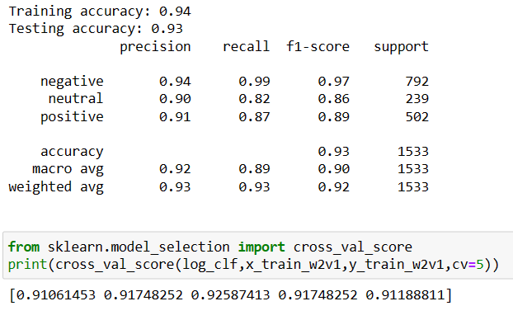
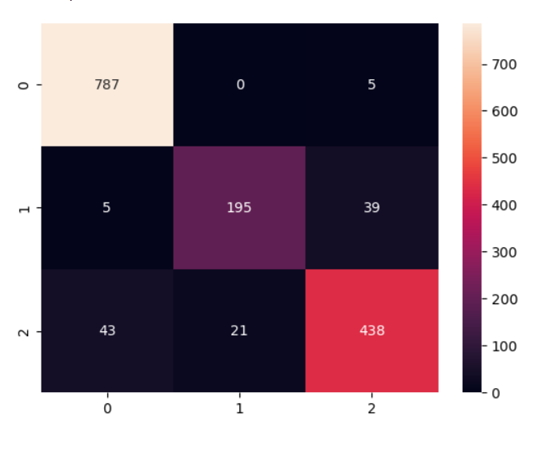
Logistic Regression

Slide 35


Support Vector Machine

Slide 36


K – Nearest Neighbor

Slide 37

Random Forest

Slide 38


XGBoost

Slide 39

Results of Pretrained Word2vec model
it can be concluded that:
- All models achieved high training accuracy above 94%, indicating that they were able to fit the training data well.
- SVM and KNN achieved the highest testing accuracy above 97%, indicating that they performed well on the unseen testing data.
- Random forest achieved the lowest testing accuracy 92.7%, while all other models achieved testing accuracy above 91%, indicating that Random forest may not be the best model for this dataset.

Slide 40
Model Deployment

Slide 41




Slide 42
Summary of Deployment
The necessary libraries and packages are imported, including Streamlit, Pandas, NumPy, NLTK, BeautifulSoup , Gensim , and Spacy.
The code defines a preprocess() function that removes HTML tags, non-alphabetical characters, digits, stop words, and lemmatizes the text.
The code loads the Vectorized TF-IDF model from the specified path and the KNN classifier that was trained on a preprocessed dataset of financial reviews.
The code defines a Streamlit app that allows users to enter a financial review text and, on button press, preprocesses the text, generates a TFIDF vector representation of the text, and predicts the sentiment of the text using the KNN classifier.
The code displays the predicted sentiment of the text as a header in the Streamlit app, with the sentiment being either positive, neutral, or negative.

Slide 43
Thank You

